Slide 1

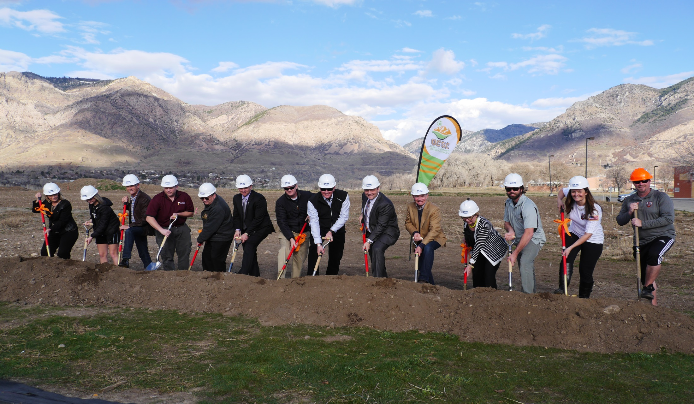
Your Quality of Life
In 2004 and in 2014, you authorized Weber County RAMP to fund enhancements for Recreation, Arts, Museums and Parks in your community.

Slide 2



Your Investment
=
RAMP is funded by a sales tax of 1/10 of 1% or one penny for every $10.
The average Weber County family invests $12 per year in RAMP.
That $12 dollars generates around $3.0 million per year for community projects.

Slide 3

RAMP in Your Community
$29,515,267 in grants for 96 non-profit organizations and municipalities

Slide 4
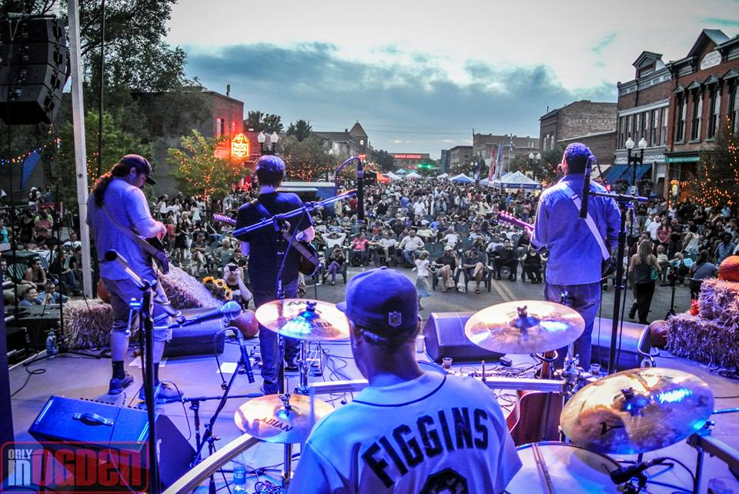
RAMP Works
Weber County has built a national reputation for quality of life based on amenities that RAMP has helped fund

Slide 5
RAMP Board
15 members
  Advisory Board Major Grants (7 members)
      Ann Parry, Chair
      Maresha Bosgieter Ryan Wilkinson
        Danette Pulley Jeremy Dunn
            Terry Schow Steven Crane
  Arts & Museum (7 members)
    Danette Pulley, Chair
    Terry Schow Steven Crane
    David Owens Jolene Zito
    Lacy Richards Renae Woods
  Parks & Rec (7 members)
  Maresha Bosgieter, Chair
  Ryan Wilkinson Jeremy Dunn
  Tim Hutter Colby Bockwoldt
  Steven Schoof Karla Woodward

Slide 6
2017 RAMP Funding
$3,474,355 Total Amount of RAMP Tax Collected
$52,115 Less Administrative Fees of 1.5%
$3,422,240
$60,000 Less EZ Grants
$3,362,240

Slide 7
2017 RAMP Funding
$3,362,240
Major Grants (1/3)
Arts & Museums – Parks & Rec (2/3)
1/3 = $1,120,746 Major Funds
- $200,000 Legacy Project
$920,746 Total
2/3 = $2,241,492
- $251,792 Municipal Grants
$1,989,700
- $70,000 Free Summer Saturdays
$1,919,700 Divided by 2
$1,433,140 in Requests
Arts & Museums
½ = $959,850
Parks & Rec
½ = $959,850
$1,585,892 in Requests
$1,741,832 in Requests

Slide 8
Eligibility
  In order to qualify for funding:
An applicant must be a Weber County city, entity or a non-profit organization operating a publicly owned facility within Weber County.
The non-profit organization must be a “resident” of Weber County and have met all eligibility requirements throughout the preceding three years.
If it is an organization or program affiliated with a university, college, or educational institution:
  It must serve predominantly the community as opposed to students and faculty.
  It must receive less than fifty percent of its support from the university, college or educational institution.

Slide 9
Completing your Grant Applications
Type of Grant
Indicate which type of RAMP grant you are requesting for this project. (Check correct square on top right of application).
1 – Major: Requests for $200,000 or greater.
2 – Regular: Requests for $2,001.00 to $199,999.
3 – EZ: Requests for $2,000 or less.
Grant Category & Classification
1 – Parks & Recreation (Your classification must be for a Recreational Facility)
2 – Arts & Museums (Your classification will be for either a Cultural Facility or Organization)

Slide 10
Include on Grant Application
Mission Statement
The mission statement of your organization should be approved by your board members or council and be in line with the statutes and ordinances that govern the RAMP tax. (Be sure your mission statement complies with RAMP)
Project Name
Provide a short title that will identify what your project is for. Do not use the same name for more than one year, if it is a multi-phase project, include the phase number in the project name. NOTE: If your organization has multiple requests, please indicate the priority of your requests. The committee will take your priority of requests into consideration during their deliberations.

Slide 11
Request Amount & Budget
Please use the budget template that is provided with the 2018 applications. This template must be turned in along with all MAJOR and REGULAR RAMP applications.
Any costs for which RAMP funds will be used must have competitive bids, estimates and/or cost comparisons.
You should also include other funding sources for the project as well as any in-kind donations or volunteer work that will be used.
Multi-phase projects- only land used for current phase can be used as collaboration.
(As a general rule, RAMP does not fund employee salaries, prizes, trophies, refreshments or food items. Any RAMP money awarded and not used as outlined in your budget must be returned to the county.)

Slide 12
Submittal
Be sure to submit 15 correlated stapled copies of your application and attachments.
Application should be filed with:
RAMP Tax Advisory Board
Weber County Commission
2380 Washington Blvd., Suite 360
Ogden, Utah 84401

Slide 13
Applications Deadlines
Filing deadline for MAJOR grants:
Friday, January 12th @ 5:00PM
Filing deadline for REGULAR grants:
Friday, January 12th @ 5:00PM
Filing deadline for EZ grants:
Friday, March 30th @ 5:00 PM

Slide 14
Recreational Facility
Recreational Facility =
Publicly Owned
Or
Operated
Campground
Dock
Marina
Golf course
Playground
Athletic field
Gymnasium
Swimming pool
Trail system
Park
Other facility used for recreational purposes

Slide 15
Cultural Facility
**Government Municipal or County entities seeking funds under the Arts or Museum category must have a cultural council with the primary purpose of promoting the advancement and preservation of history, natural history, art, music, theater or dance.
Cultural Facility
Publicly Owned
Or
Operated
Theater
Museum
Art center
Music hall
Other cultural or arts facility

Slide 16
Cultural Organization
1.
Primary purpose is the advancement
Organization
and preservation
of
•
Natural history
•
Private non-profit
Institution
History
•
Art
•
Administrative Unit
Music
•
A
n administrative unit is a division of a non-profit organization or
Theater
•
insti
tution
that:
Dance
a) would, if it were a separate entity be a cultural organization
•
and
b) consistently maintain books and records separate from those
Literature
•
of its parent organization. (UCA 59
Motion pictures
-
12
-
702(1)
•
Story telling
Primary purpose is the advancement and preservation of
History
Natural history
Art
Music
Theater
Dance
Municipal Or County
Cultural Council

Slide 17
Criteria for Funding
The burden is on the applicant to demonstrate convincingly that it meets all eligibility requirements.
• All funded facilities must be physically located in Weber County. (When possible, it is also
recommended that funds be spent with vendors in Weber County).
• Preference will be given to collaborative projects and projects that are funded in part
by the applying entities.
• On the basis of the grant, the applying entities are encouraged to raise additional monies
specifically for the funded project.
• Applying entities must provide for perpetual maintenance and operating funding for all
facilities for which funding is requested.
• All funded projects must be made available for use to all Weber County residents.
• Reasonable non-discriminatory user fees may be charged for the use of the facilities.
• The total amount of grant money must be spent on the funded project and must be used
within Weber County.

Slide 18
Application Review Process
(100 Points Available)
1) 0-20 Does the project have matching funds? (Include in-kind/volunteer hours, etc.)
2) 0-10 Do some of the matching funds for the project come from community partners/private sponsors/non-profit funds (non tax-dollar)?
3) 0-15 Does the project show collaboration with other Weber County entities (letters of support, etc.) to reach a greater community population?
4) 0-15 Does the project endorse durability, longevity or enhancement benefits to Weber County residents? Does the project fulfill a current need?
5) 0-10 Are the cost ratios appropriate? How many people will attend, use or participate? What is the average cost per person?
0-10 Rate the project for ongoing maintenance or sustainability. Is the community
assisting in the continued maintenance?
7) 0-5 Are the details of the project clearly defined for the use of RAMP funds?
8) 0-5 Are competitive estimates and cost comparisons included if applicable? (N/A = 5)
9) 0-5 Should this project be funded?
10) 0-5 Did the entity attend training?
**REDUCTION OF POINTS Completion report turned in late -10 Pts, no completion
report turned in or entity failed audit on last project -25 Pts.

Slide 19
Reporting and Audits Changes
Progress reports are no longer required.
Completion reports are due April 30th or 60 days after project is complete, whichever comes first. You will lose points on future grant requests for late reports.
You are required to turn in a list of all RAMP expenses.
You are required to turn in proof of ALL RAMP expenses.
Only one, 1-year extension will be allowed.

Slide 20
Key Changes
Reduction in points on future requests, for late reports, no reports or failed audits.
Points will be awarded for non tax-dollar collaboration.
Only one, 1-year extension will be allowed.
Each entity can only turn in a total of:
1 - Major Grant Application
3 - Regular Applications in each- Parks & Recreation and
Arts & Museums
3 -EZ Grant Applications
Multi-phase projects can only use land area in the current phase as collaboration.

