Slide 1
RAMP Grant Application Training
2024 RAMP Grant Year

Slide 2
RAMP Board 15 COMMUNITY MEMBERS
Arts & Museums
(7 members)
Advisory Board
(7 members)
Recreation & Parks
(7 members)
Lacy Richards, Chair
Kevin Burns
Ernie Gonzalez
Kenna Brown
Sunni Wilkinson
Sheri Bingham
Korry Green
Ernie Gonzales, Chair
Sunni Wilkinson
Sheri Bingham
Jim Craig
Dana Gibson
Sylvia Newman
Jordan Brun
Kevin Burns, Chair
Korry Green
Kenna Brown
Liz Morrison
Sara Urry
Bret Holmes
Zachary Thomas

Slide 3
Your Quality of Life
In 2004 and again in 2014, you authorized Weber County RAMP to fund enhancements for Recreation, Arts, Museums and Parks in your community.

Slide 4
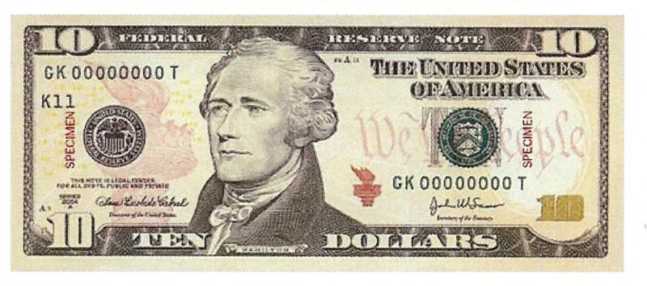
Your Investment
=
RAMP is funded by a sales tax of 1/10 of 1% or one penny for every $10.
The average Weber County family invests $12 per year in RAMP.
That $12 dollars generates more than $3 million per year for community projects.

Slide 5
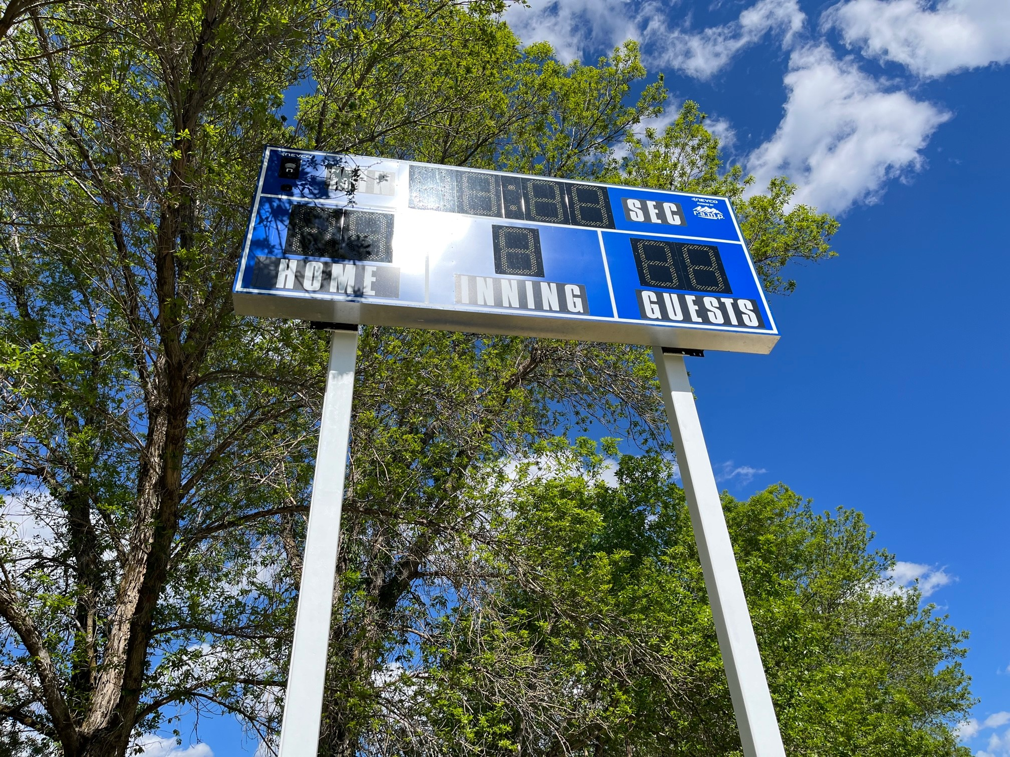
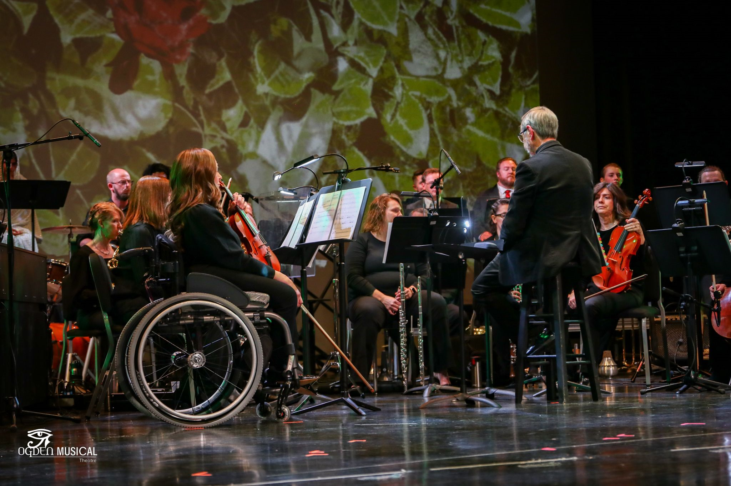
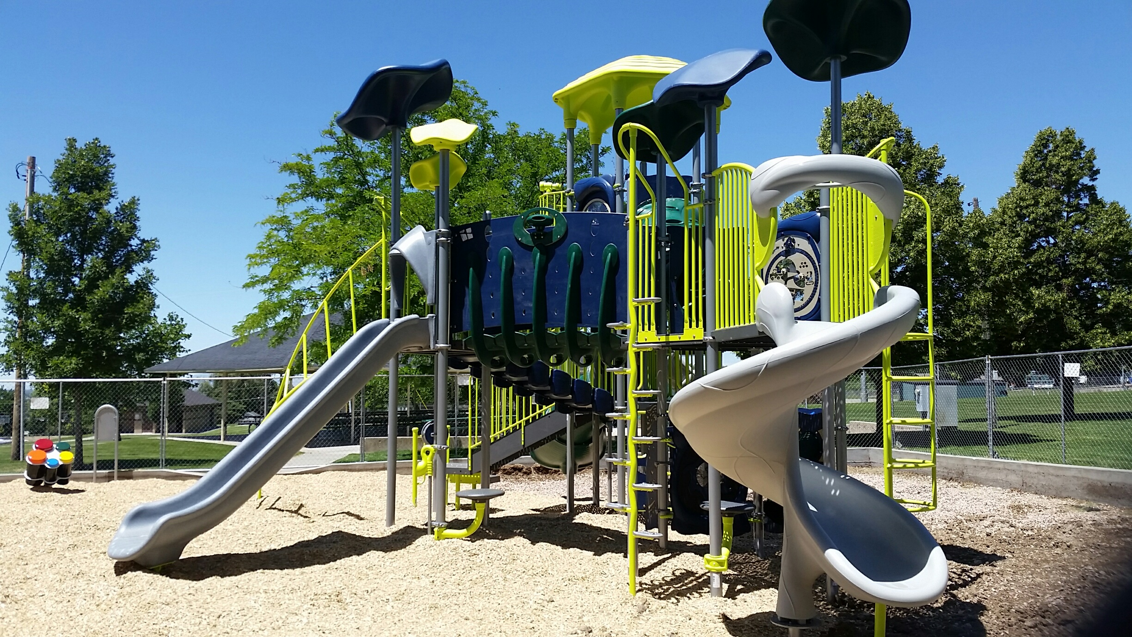
RAMP in Weber County Over $61,000,000 in grants have been invested in our community through RAMP. Over 120 non-profit organizations and municipalities have been able to create amazing projects and programs because of RAMP.

Slide 6
The RAMP Tax will be on the ballot again in 2024. Please remember to share how amazing RAMP is with everyone you know! We would love another ten years of RAMP!

Slide 7
2024 RAMP Funding
$6,092,000
Major Grants (1/3)
Arts & Museums – Parks & Rec (2/3)
1/3 = $2,030,666 Major Funds
2/3 = $4,061,333
- $273,073 Municipal Grants
$3,788,260
- $80,000 Free Summer Saturdays
$3,708,,260 Divided by 2
Arts & Museums
½ = $1,854,130
Parks & Rec
½ = $1,854,130
$ in Requests
$ in Requests
$ in Requests

Slide 8
2023 RAMP Funding
$6,500,000
Major Grants (1/3)
Arts & Museums – Parks & Rec (2/3)
1/3 = $2,166,666 Major Funds
+ $3,315,000 One time Savings from Prior Years
$5,481,666
2/3 = $4,333,333
- $273,073 Municipal Grants
$4,060,260
- $70,000 Free Summer Saturdays
$3,990,260 Divided by 2
$10,267,665 in Requests
Arts & Museums
½ = $1,995,130
Parks & Rec
½ = $1,995,130
$3,006,629 in Requests
$2,860,561 in Requests

Slide 9
Eligibility
In order to qualify for funding:
An applicant must be a Weber County city, entity or a non-profit organization operating within Weber County.
The non-profit organization must be a “resident” of Weber County and have met all eligibility requirements for the preceding three years.
If it is an organization or program affiliated with a university, college, or educational institution:
The project must serve predominantly the community as opposed to students and faculty.
The institution must receive less than fifty percent of its support from government funding.

Slide 10
Recreational Facility For Recreational and Parks purposes, RAMP Tax may be used to fund recreational facilities. RAMP Ordinance 24-7-1; 24-7-3; 24-7-4
Recreational Facility
Campground
Dock
Marina
Golf course
Playground
Athletic field
Gymnasium
Swimming pool
Trail system
Park
Other facility used for recreational purposes
Publicly Owned
Or
Operated

Slide 11
Cultural Facility For Arts and Museums purposes, RAMP Tax may be use to fund Cultural Organizations or Cultural Facilities. RAMP Ordinance 24-7-1; 24-7-3; 24-7-7
Cultural Facility
Publicly Owned
Or
Operated
Theater
Museum
Art center
Music hall
Other cultural or arts facility

Slide 12
Cultural Organization
Primary purpose is the advancement
Organization
and preservation
of -
Natural History
Private non-profit
Institution
History
Art
Administrative Unit
Music
Theater
Dance
An administrative unit is division of a non-profit organization or institution that-
a. would, if it were a separate entity be a cultural organization.
and
b. consistently maintain books and records separate from those of its
parent organization (UCA-5912-702(1)
Literature
-
-
Motion pictures
Story telling
Primary purpose is the advancement
and preservation of -
History
Natural history
Art
Music
Theater
Dance
Municipal or County
Cultural Council

Slide 13
Criteria for Funding
The burden is on the applicant to demonstrate that it meets all eligibility requirements.
All funded facilities must be physically located in Weber County. (When possible, it is also recommended that funds be spent with vendors in Weber County).
Preference will be given to collaborative projects and projects that are funded in part by the applying entities.
On the basis of the grant, the applying entities are encouraged to raise additional monies specifically for the funded project.
Applying entities must provide for perpetual maintenance and operating funding for all facilities for which funding is requested.
All funded projects must be made available for use to all Weber County residents.
Reasonable non-discriminatory user fees may be charged for the use of the facilities.
The total amount of grant money must be spent on the funded project and must be used within Weber County.
NOTE- If you are planning a “Recreation Festival” check the Arts & Museums Box and make sure your mission statement matches.

Slide 14
What RAMP Won’t Fund-
RAMP does not fund contingency fees, insurance, architecture, studies, employee salaries, prizes, trophies, refreshments, fireworks, food items, city marquee/message boards, or fundraisers.
Stipends are only paid for special guest performers, teachers or musicians. Employees or regular performers cannot be paid with RAMP funds.
Project planning, design, architecture, etc. can be used as a match but cannot be a paid expense of a RAMP grant.
Any RAMP money awarded and not used as outlined in your budget must be returned to the county.
Costs such as police, fire department, trash pick-up, city workers, etc., should only be included if they are a real expense for the project that funding is being requested for.
RAMP will not be the first funding on a project.
RAMP funds cannot be re-granted.
RAMP is never guaranteed.

Slide 15
Application Deadlines
Major Grants
Regular Grants
EZ Grants
Filing Deadline-
Friday,
January 12, 2024
by 5:00 PM
Filing Deadline-
Friday,
January 12, 2024
by 5:00 PM
Filing Deadline-
Friday,
March 22, 2024
By 5:00 PM
Submit 15 collated and stapled copies of your application to-
2380 Washington Blvd, Ste. 360, (Commission Office), Ogden, UT 84401.
Make sure you have included everything on the checklist!
DO NOT INCLUDE COVER LETTERS, FOLDERS OR BINDERS!

Slide 16
Include on Your RAMP Grant Application
Amount applying for- Whole numbers only, no change
Type of Grant (Check correct square on top right of application).
1 – Major: Requests for $200,000 or greater.
2 – Regular: Requests for $2,001.00 to $199,999.
3 – EZ: Requests for $2,000 or less.
Grant Category & Classification
1 – Parks & Recreation
Your classification must be for a Recreational Facility
2 – Arts & Museums
Your classification will be for either a Cultural Facility or Organization
Mission Statement
The mission statement of your organization should be approved by your board members or council and be in line with the statutes and ordinances that govern the RAMP tax. (Be sure your mission statement complies with RAMP- Recreation, Arts, Museums, Parks that improve quality of life for Weber County residents). If you change your mission statement to align with RAMP, please get your boards approval.
It must be permanent, not just for RAMP applications.
Project Name
Provide a short title that will identify what your project is for. Do not use the same name for more than one year, if it is a multi-phase project, include the phase number in the project name. NOTE: If your organization has multiple requests, please indicate the priority of your requests. The committee will take your priority of requests into consideration during their deliberations.
EZ Grant Applications
EZ grant applications must include a summary and a budget.

Slide 17
Budget Reminders
The budget form on the RAMP website is now required.
Any costs for which RAMP funds will be used must have competitive bids/estimates and/or cost comparisons.
Budgets must include a list of all project expenses with a separate list of RAMP expenses.
Always include other funding sources for the project as well as any in-kind donations or volunteer work that will be used.

Slide 18
FINAL REMINDERS
Completion Reports are due June 30th of the following year.
Points will be deducted for late reports, no reports or failed audits.
Points will be awarded for non tax-dollar collaboration.
Only one, 1-year extension will be allowed.
Each entity can only turn in a total of:
(1) Major Grant Application
(3) Regular Applications per category
(3) Parks & Recreation
(3) Arts & Museums
(3) EZ Grant Applications
Multi-phase projects can only use land area in the current phase as a match.
Grant writers- If you have hired a grant writer, review the application with the grant writer, before it is submitted. Keep a copy of your application so that you are able to answer questions when you meet with your liaison. Please have main contact for your project be someone from your entity, grant writer can be second contact.

Slide 19
QUESTIONS
For questions contact:
Shelly Halacy (801)399-8405
Stacy Skeen (801)399-8403

